Slide 1
Suggested answers

Slide 2
Case 1
CXR
Widened mediastinum
Calcium sign
Tracheal deviation
Obliteration of aortopulmonary window

Slide 3
CT
IMH from ascending aorta to distal aortic arch
Pericardial effusion

Slide 4
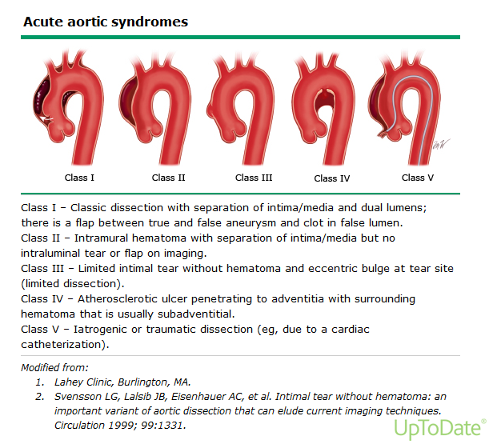

Slide 5
Operative treatment

Slide 6
Case 2
Lateral x ray
Expectant and FU with serial radiographs
Precautions
Remove any magnetic objects nearby
Avoid clothes with metallic buttons and belts with buckles
Ensure that no other metal objects or magnets are ingested
Observe for abdominal pain, fever, vomiting

Slide 7
Case 3
Acute interhemispheric subdural haematoma
R frontal contusion
L high parietal SAH

Slide 8
Falx syndrome
Contralateral monoparesis of the leg or hemiplegia with predominant involvement of the leg
Clouding of consciousness, cognitive impairment, language disorders, gait instability, and oculomotor dysfunction
Shea Y-F, et al., An uncommon complication of fall in the elderly: Interhemispheric subdural hematoma, Journal of Clinical Gerontology & Geriatrics (2013)

Slide 9
Case 4
ECG
SR 46/min
ST elevation in inferior leads
Reciprocal ST depression in aVL
Acute inferior MI

Slide 10
Complications
Arrthymias
Cardiogenic shock
Myocardial rupture
Acute MR
Pericarditis

Slide 11
Case 5
ECG
Tachycardia 168/min
Borderline QRS width
LBBB

Slide 12
SVT with aberrant conduction
VT

Slide 13
Features favouring VT
Absence of typical RBBB or LBBB morphology
Extreme axis deviation
Very broad complexes (>160ms)
AV dissociation
Capture beats
Fusion beats
Positive or negative concordance throughout the chest leads
Brugada’s sign

Slide 14
Josephson’s sign
RSR’ complexes with a taller left rabbit ear
High specificities but very low sensitivities
If in doubt, treat as VT!
https://lifeinthefastlane.com/ecg-library/basics/vt_vs_svt/

Slide 15
Treatment
ATP

Slide 17
The end

